Slide 1
Chapter 25
All-Pairs Shortest Paths
Sun-Yuan Hsieh
謝孫源 教授
成功大學資訊工程學系

Slide 2
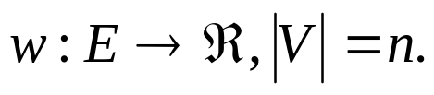

Overview
Given a directed graph G=(V,E), weight function
Goal: create an n×n matrix of shortest-path distances δ(u, v).
Could run BELLMAN-FORD once from each vertex: O(V²E) — which is O(V⁴) if the graph is dense (E=θ(V²)).
If no negative-weight edges, could run Dijkstra’s algorithm once from each vertex: O(VE lgV) with binary heap—O(V³ lgV) if dense. O(V² lgV+VE) with Fibonacci heap — O(V³) if dense.
We’ll see how to do in O(V³) in all cases, with no fancy data structure.

Slide 3
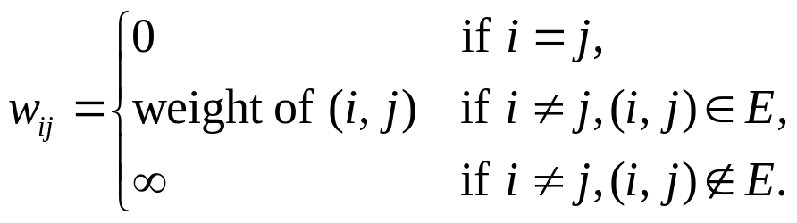
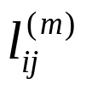
Shortest paths and matrix multiplication
Assume that G is given as adjacency matrix of weights: W = (w_{ij}), with vertices numbered 1 to n.
Output is matrix D = (d_{ij}), where d_{ij} = δ(i,j). Won’t worry about predecessor—see book.
Will use dynamic programmingat first.
Optimal substructure: Recall: subpaths of shortest paths are shortest paths.
Recursive solution: Let = weight of shortest path i j that contains ≦m edges.

Slide 4


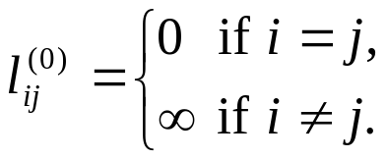

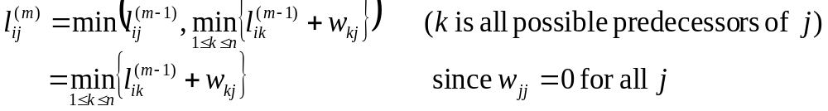

m = 0 there is a shortest path i j with ≦m edges if and only if i=j
m≧1
Observer that when m=1, must have Conceptually, when the path is restricted to at most 1 edge, the weight of the shortest path i j must be w_{ij}.
And the math works out, too:

Slide 5
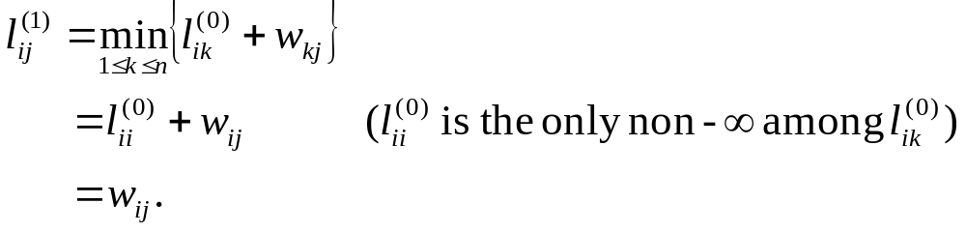
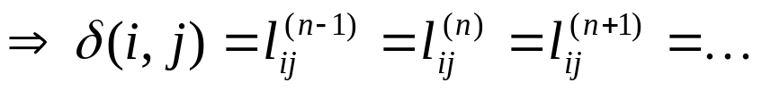
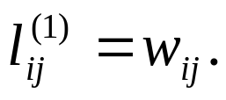
All simple shortest paths contain ≦n-1 edges
Compute a solution bottom-up: Compute L⁽¹⁾, L⁽²⁾,…,L^{(n-1)}.
Start with L⁽¹⁾ =W, since
Go from L^{(m-1)} to L^{(m)}:

Slide 6


EXTEND(L, W, n)
create L’, an n×n matrix
for i←1 to n
do for j ←1 to n
do
for k ←1 to n
do
return L’
Compute each L^{(m)}:
SLOW-APSP(W, n)
L⁽¹⁾ ←W
for m ←2 to n-1
do L^{(m)} ← EXTEND(L^{(m-1)}, W, n)
return L^{(n-1)}

Slide 7
Time:
EXTEND: Θ(n³).
SLOW-APSP: Θ(n⁴).
Observation: EXTEND is like matrix multiplication:
L → A
W → B
L’ → C
min → +
+ → ．
∞ → 0

Slide 8

create C, an n×n matrix
for i←1 to n
do for j ←1 to n
do c_{ij} ←0
for k ←1 to n
do c_{ij} ← a_{ik}．b_{kj}
So, we can view EXTEND as just like matrix multiplication!
Why do we care?
Because our goal is to compute L^{(n-1)} as fast as we can. Don’t need to
Compute all the intermediate L⁽¹⁾, L⁽²⁾, L⁽³⁾,…,L^{(n-2)}.
Suppose we had a matrix A and we wanted to compute A^{n-1} (like calling
EXTEND n-1 times).
Could compute A, A², A⁴, A⁸,…
If we knew A^{m}=A^{n-1} for all m≧n-1, could just finish with A^{r}, where r is the
smallest power of 2 that’s ≧ n-1. ( )

Slide 9
FASTER-APSP(W, n)
L⁽¹⁾ ← W
m ←1
while m < n-1
do L^{(2m)} ← EXTEND(L^{(m)}, L^{(m)}, n)
m ←2m
return L^{(m)}
OK to overshoot, since products don’t change after L^{(n-1)}.
Time:Θ(n³lgn)

Slide 10

Floyd-Warshall algorithm
A different dynamic-programming approach.
For path p=<v₁, v₂,…, v_{l}>, an intermediate vertex is any vertex of p other
than v₁ or v_{l}.
Let = shortest-path weight of any path i j with all intermediate vertices
in {1, 2,…, k}.
Consider a shortest path i j with all intermediate vertices in
{1,2,…,k}:
If k is not an intermediate vertex, then all intermediate vertices of p are in
{1, 2,…, k-1}.
If k is an intermediate vertex:
p
p₁
p₂
i
k
j
all intermediate vertices in {1, 2,…, k-1}

Slide 11
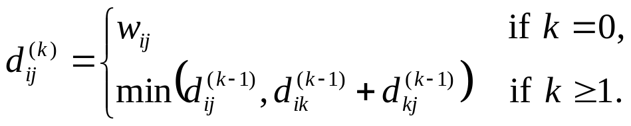


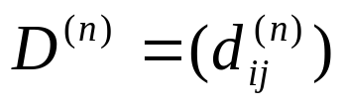
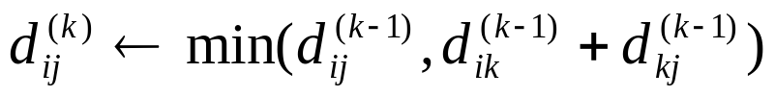
Recursive formulation
(Have because can’t have intermediate vertices ≦1 edges. )
Want , since all vertices numbered ≦n.
Compute bottom-up
Compute in increasing order of k:
Floyd-Warshall(W, n)
D⁽⁰⁾ ← W
for k←1 to n
do for i ←1 to n
do for j ←1 to n
do
return D^{(n)}

Slide 12
Can drop superscripts. (See Exercise 25.2-4 in text.)
Time:Θ(n³).
Transitive closure
Given G(V,E), directed.
Compute G* = (V, E*).
E*={ (i, j) : there is a path i j in G}.
Could assign weight of 1 to each edge, then run FLOYD-WARSHALL.
If d_{ij}<n, then there is a path i j.
Otherwise, d_{ij}=∞ and there is no path.

Slide 13


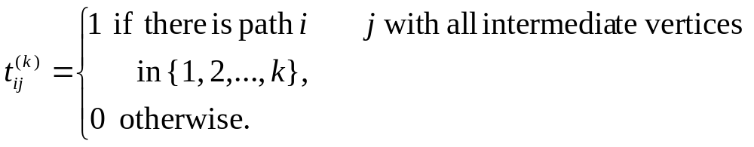
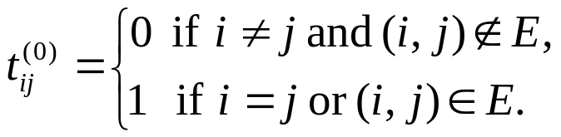
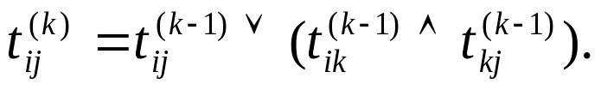
Simpler way: Substitute other values and operators in FLOYD-WARSHALL.
Use unweighted adjacency matrix
min → (OR)
+ → (AND)

Slide 14




TRANSITIVE-CLOSURE(E, n)
for i←1 to n
do for j ←1 to n
do if i=j or (i, j) E[G]
then
else
for k ←1 to n
do for i ←1 to n
do for j ←1 to n
do
return T^{(n)}
Time: Θ(n³), but simpler operations than FLOYD-WARSHALL.

Slide 15
Idea: If the graph is sparse, it pays to run Dijkstra’s algorithm once from each vertex.
If we use a Fibonacci heap for the priority queue, the running time is down to O(V²lgV + VE), which is better than FLOYD-WARSHALL’s Θ(V³) time if E=o(V²).
But Dijkstra’s algorithm requires that all edge weights be nonnegative.
Donald Johnson figured out how to make an equivalent graph that does have all edge weights≧0.

Slide 16



Reweighting
Compute a new weight function such that
For all u, v V, p is a shortest path u v using w if and only if p is a shortest path u v using .
For all (u, v) E,
Property(1) says that it suffices to find shortest paths with .
Property(2) says we can do so by running Dijkstra’s algorithm from each vertex.
How to come up with ?
Lemma shows it’s easy to get property(1):

Slide 17

Lemma (Rewighting doesn’t change shortest paths)
Given a directed, weighted graph G=(V,E), w: E→R . Let h be any function such that h:V →R .
For all (u, v) E, define
Let p=<v₀, v₁,…,v_{k}> be any path v₀ v_{k} .
Then, p is a shortest path v₀ v_{k} with w if and only if p is a shortest path v₀ v_{k} with . Also, G has a negative-weight cycle with weight w iff G has a negative-weight cycle with weight .

Slide 18

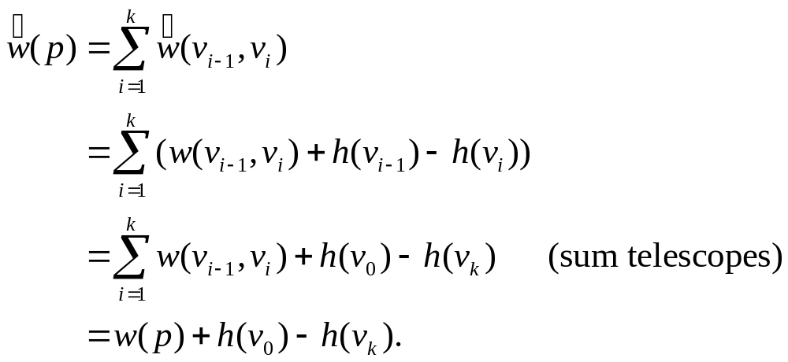

Proof
First, we’ll show that :
Therefore, any path v₀ v_{k} has .
Since h(v₀) and h(v_{k}) don’t depend on the path from v₀ to v_{k}, if one path v₀ v_{k} is shorter than another with w, it’s also shorter with .
Now show there exists a negative-weight cycle with w if and only if there exists a negative-weight cycle with :
p

Slide 19
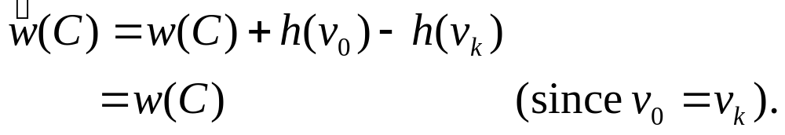


Let cycle C=<v₀, v₁,…, v_{k}>, where v₀=v_{k}.
Then
Therefore, C has a negative-weight cycle with w if and only
if it has a negative-weight cycle with . ■ (lemma)
So, now to get property(2), we just need to come up with a function
h: V→R such that when we compute
Do what we did for difference constraints:
G’=(V’, E’)
V’=V∪{s}, where s is a new vertex.
E’=E∪{ (s, v): v V}.
w(s, v) = 0 for all v V.

Slide 20
0
0
-1
a
3
4
s
0
0
8
-5
b
e
-4
2
-5
0
7
1
0
-4
0
c
d
6
Figure 25.6 Johnson’s all-pairs shortest-paths algorithm
(a) The graph G’ with the original weight function w. The new vertex s is black.

Slide 21
Since no edges enter s, G’ has the same set of cycles as G. In particular, G’ has a negative-weight cycle if and only if G does.
Define h(v) = δ(s, v) for all v V.
Claim
Proof By the triangle inequality,
δ(s, v) ≦ δ(s, u) + w(u, v)
h(v) ≦ h(u) + w(u, v) .
Therefore, w(u, v) + h(u)- h(v) ≧0. ■(claim)

Slide 22

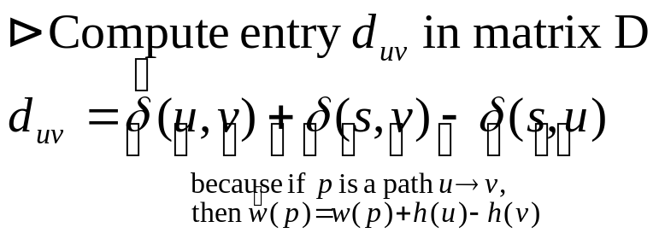
Johnson’s algorithm
from G’
run BELLMAN-FORD on G’ to compute δ(s, v) for all v V
if BELLMAN-FORD returns FALSE
then G has a negative-weight cycle
else
compute for all (u, v) E
for each vertex u V
do run Dijkstra’s algorithm from u using weight function
to compute
for each vertex v V
do

Slide 23

Time:
Θ(V+E) to compute G’.
O(VE) to run BELLMAN-FORD.
Θ(E) to compute .
O(V²lgV+VE) to run Dijkstra’s algorithm times (using Fibonacci heap).
Θ(V²) to compute D matrix.
Total: O(V²lgV + VE).

